Slide 1
Voting Matters
So, let’s talk about it!
6pm, Thursday,
Oct. 29, 2020
Santa Cruz
County Clerk
Gail L. Pellerin

Slide 2
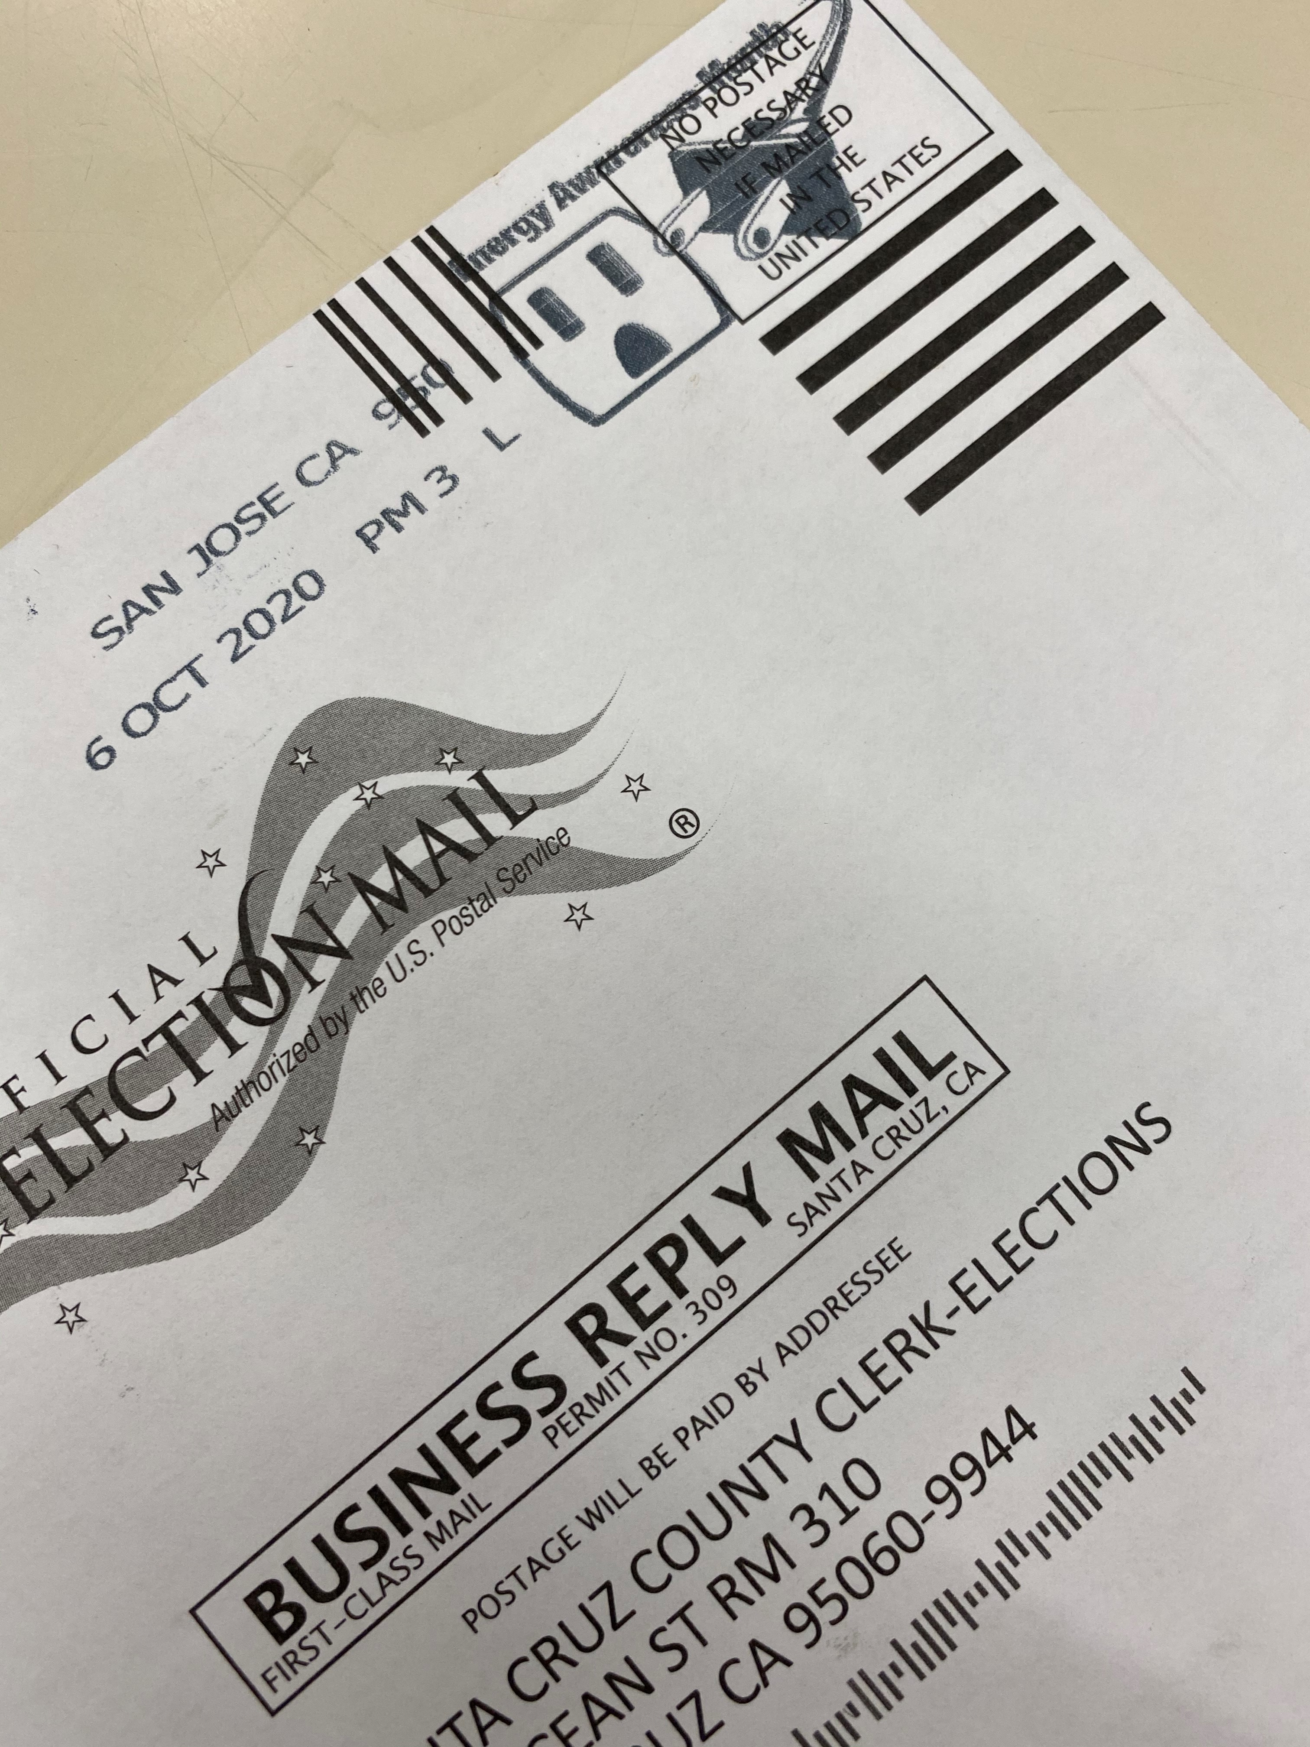
Yes, you can still return your ballot by mail!
At this point, if you mail your ballot, walk it into the post office and have it postmarked!
Ballots postmarked on or before November 3 and received by the elections official by November 20 will be considered received on time and will be counted if the voter is eligible to vote.
Postage is paid!

Slide 3
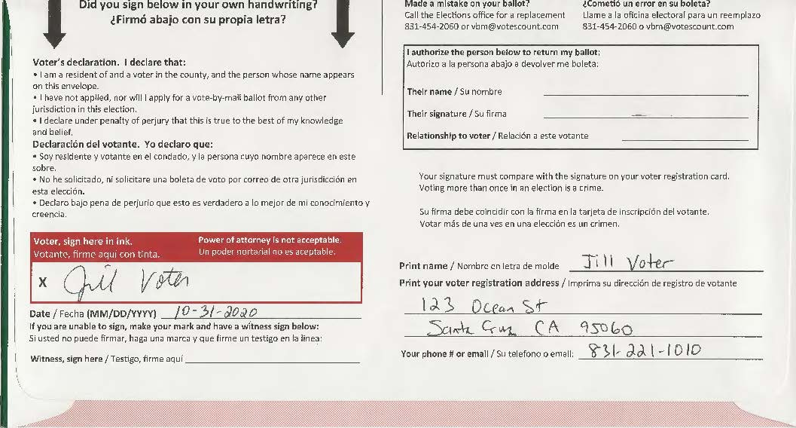
Make sure you sign your ballot envelope in your own handwriting

Slide 4
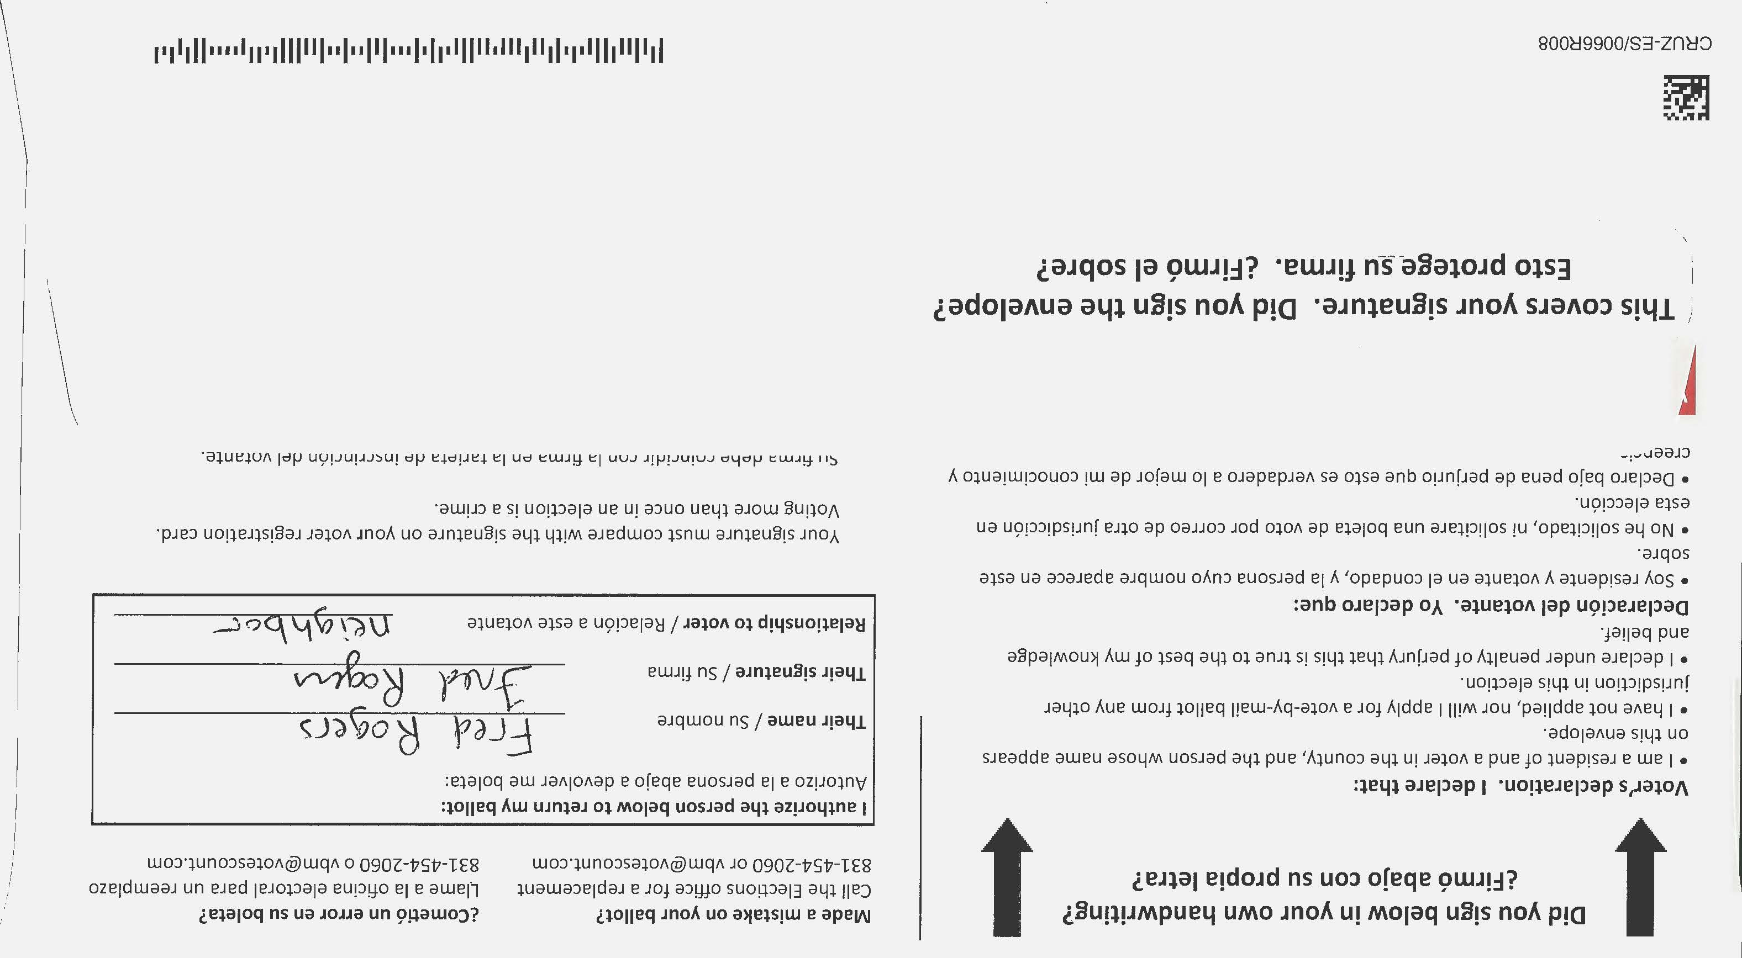
If you need to ask someone you trust to return your ballot
Make sure the person returning your ballot fills out this section on the envelope:
Their name
Their signature
Their relationship to you

Slide 5
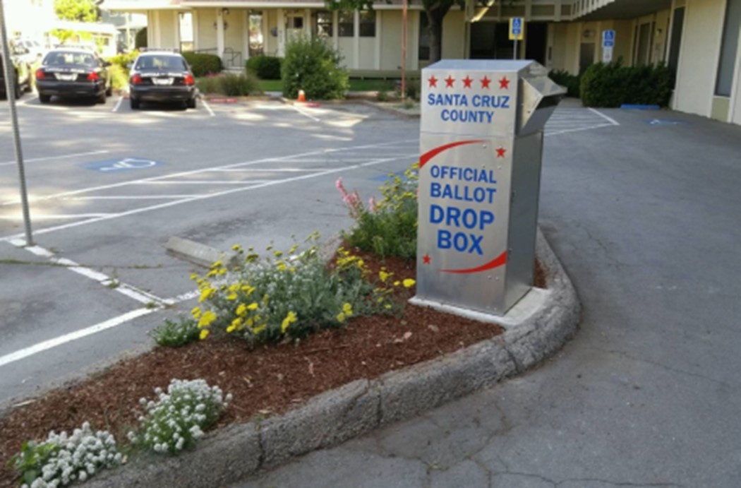
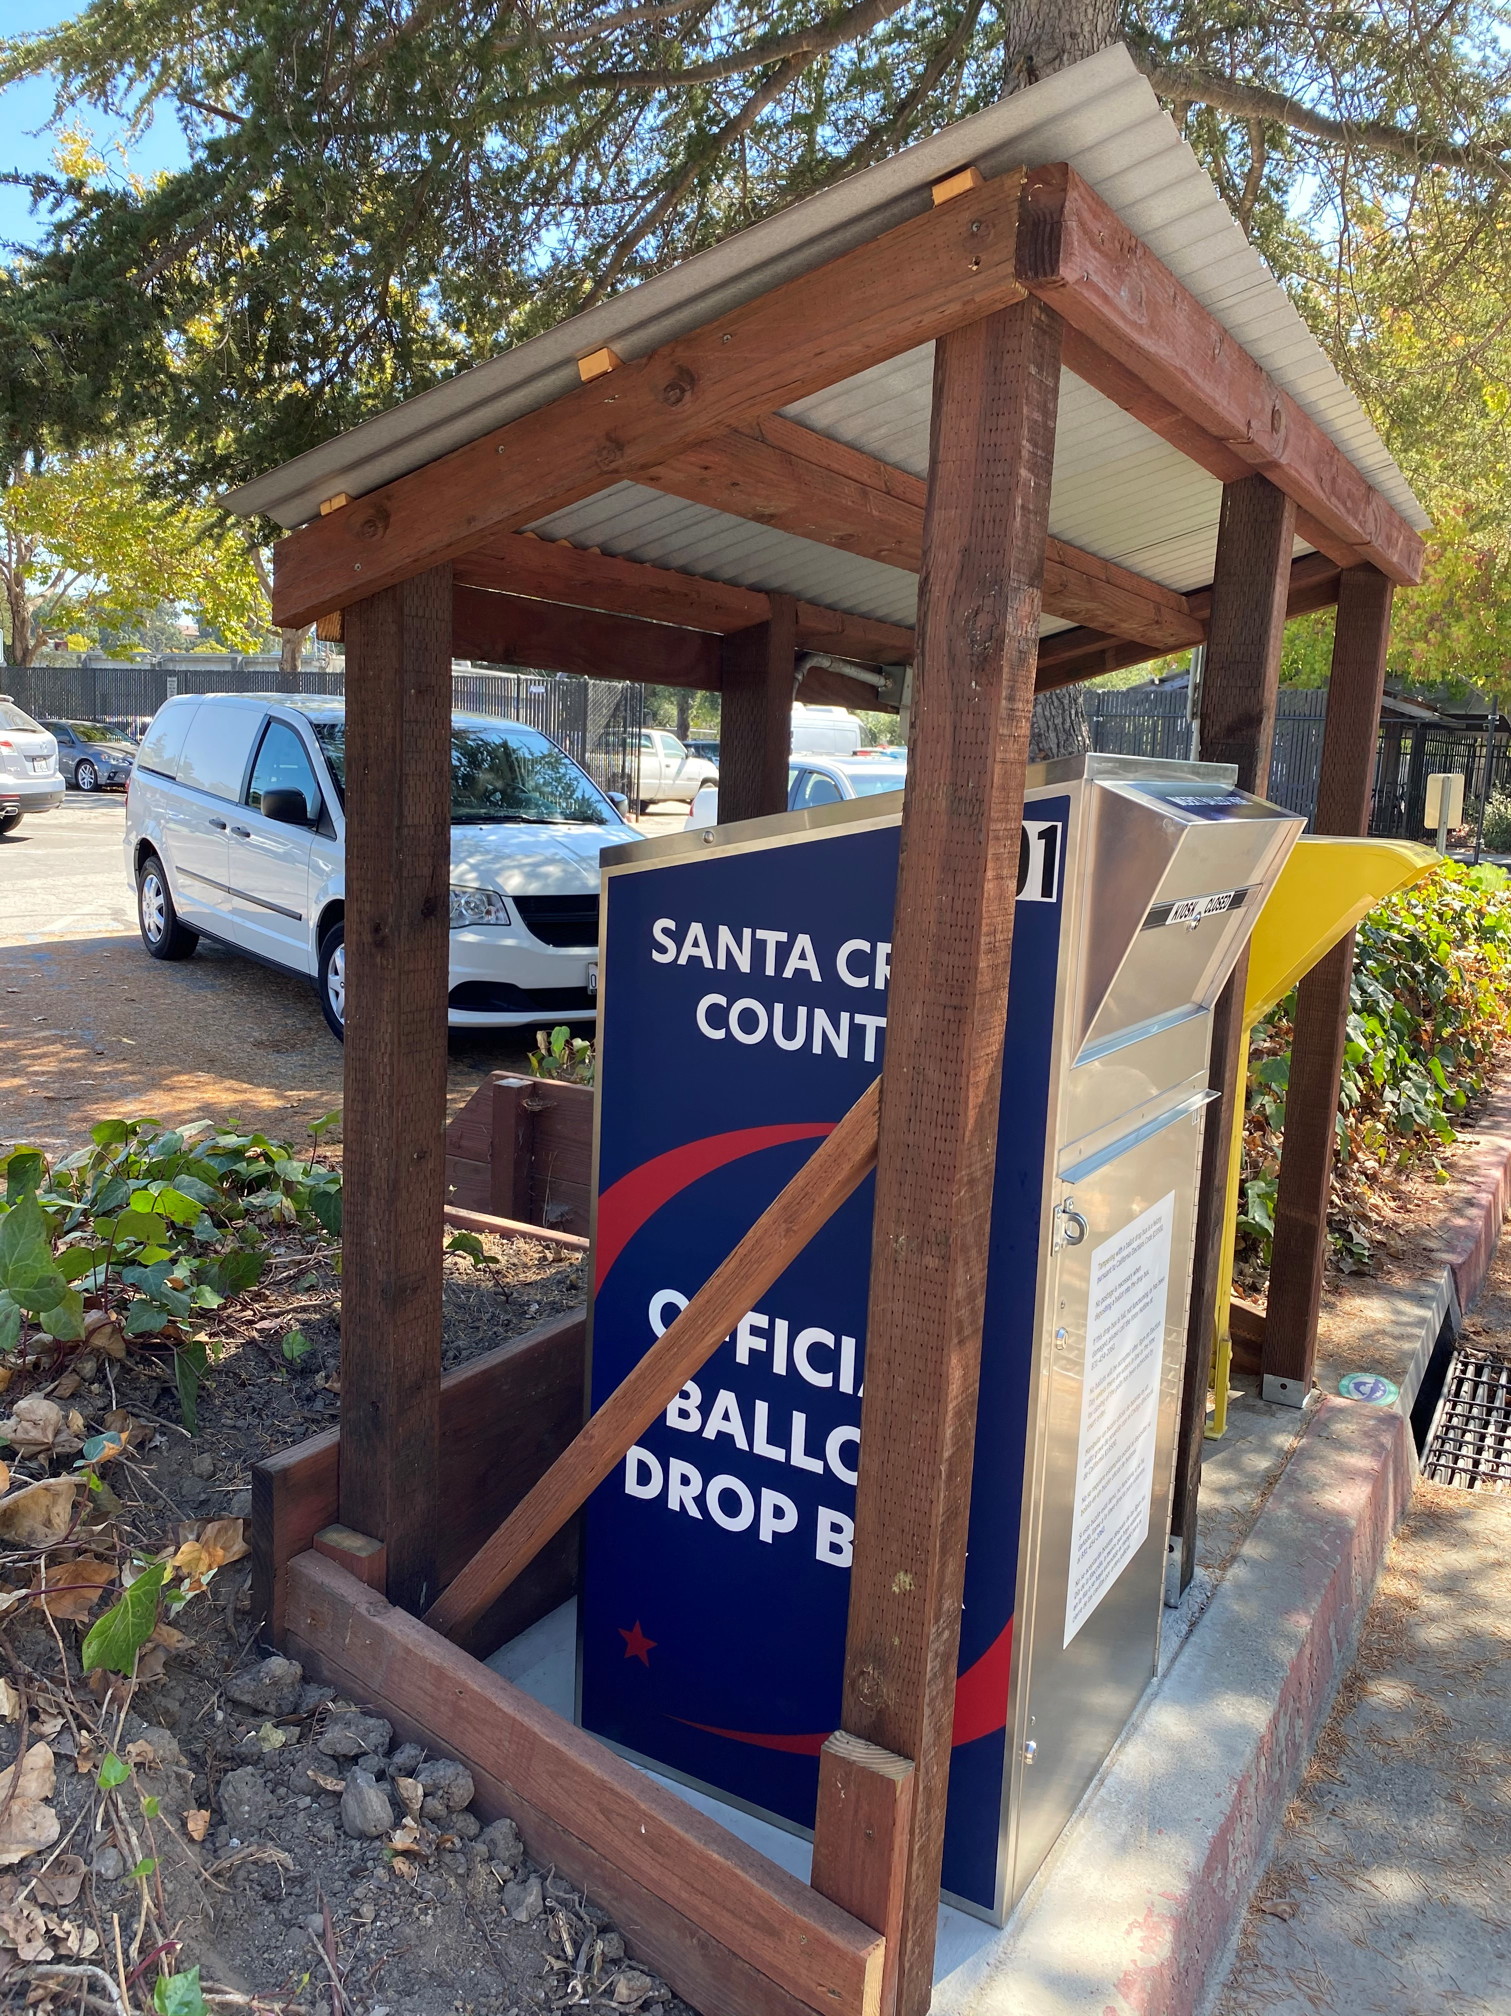
Official Ballot Drop Boxes
Our outdoor boxes are available 24/7. They are either silver or blue. They both clearly indicate that it is an Official Ballot Drop Box for Santa Cruz County. The laws governing the boxes are posted on the front of the box.

Slide 6
Are the boxes secure?
Boxes are bolted to the ground from the inside.
A two-person team has been assigned to each box. They are emptying the boxes at least once a day, more frequently as we get closer to Election Day.
There is chain of custody documentation that must be completed by the team and verified by the elections officials accepting the ballots at County Elections.
To open the box, the elections officials must cut the wire seal containing a unique number and unlock the padlock. Two keys must be used to unlock the box to access the ballots.
When completed, the team locks the box and uses a new wire seal. The number of the new seal is recorded on the documentation.

Slide 7
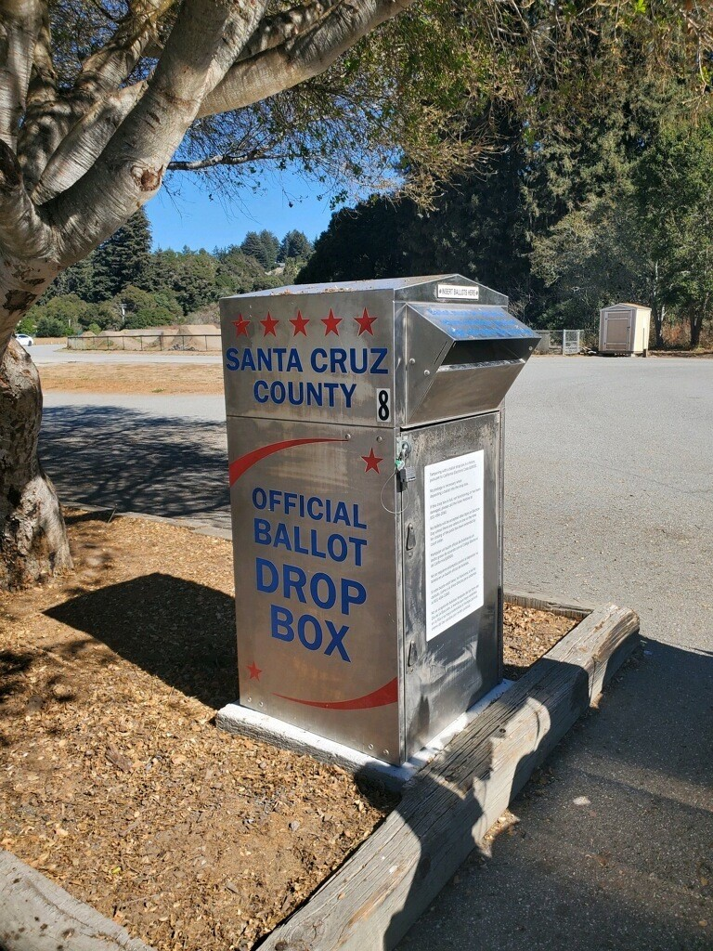
Ballot drop box locations
Aptos - Public Library parking lot, 7695 Soquel Dr.
Aptos - Polo Grounds, 2255 Huntington Dr.
Aptos - Cabrillo College by football stadium, 3732 Cabrillo College Dr.
Ben Lomond - Highlands Park parking lot, 8500 Highway 9
Boulder Creek – Public Library, 13390 W. Park Ave.: walk up
Capitola - City Hall parking lot, 420 Capitola Ave.
Capitola - Shopping Mall Capitola Rd. side, near Bank of America, 1855 41st Ave.
Felton - Covered Bridge Park parking lot, Mt. Hermon/Graham Hill Rd.
Santa Cruz - County Gov. Center parking lot, 701 Ocean St.
Santa Cruz - Public Library parking lot, 212 Church St.
Santa Cruz - UCSC Quarry Plaza: walk up
Scotts Valley - City Hall parking lot, 1 Civic Center Dr.
Watsonville - Parking Lot 14, 316 Rodriguez St.
Watsonville - County Health Center parking lot, 1430 Freedom Blvd.
Watsonville - Corralitos Community Center parking lot, 35 Browns Valley Rd.

Slide 8
Inside ballot drop box locations
County Elections: 701 Ocean St., Room 310, Santa Cruz
Santa Cruz City Clerk: 809 Center St., Santa Cruz
Simpkins Swim Center: 979 17th Ave., Santa Cruz
Capitola City Clerk: 420 Capitola Ave., Capitola
Watsonville City Clerk: 275 Main St., 4th Floor, Watsonville
Watsonville Public Library: 275 Main St., 1st Floor, Watsonville
We will also have a drop box at each residential care facility for their residents.
*No box at Scotts Valley City Hall since they are closed to the public.

Slide 9
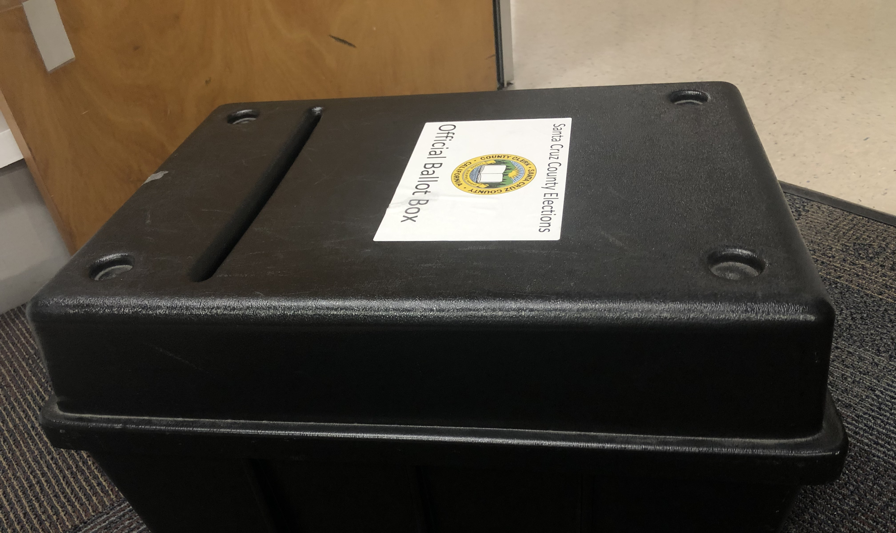
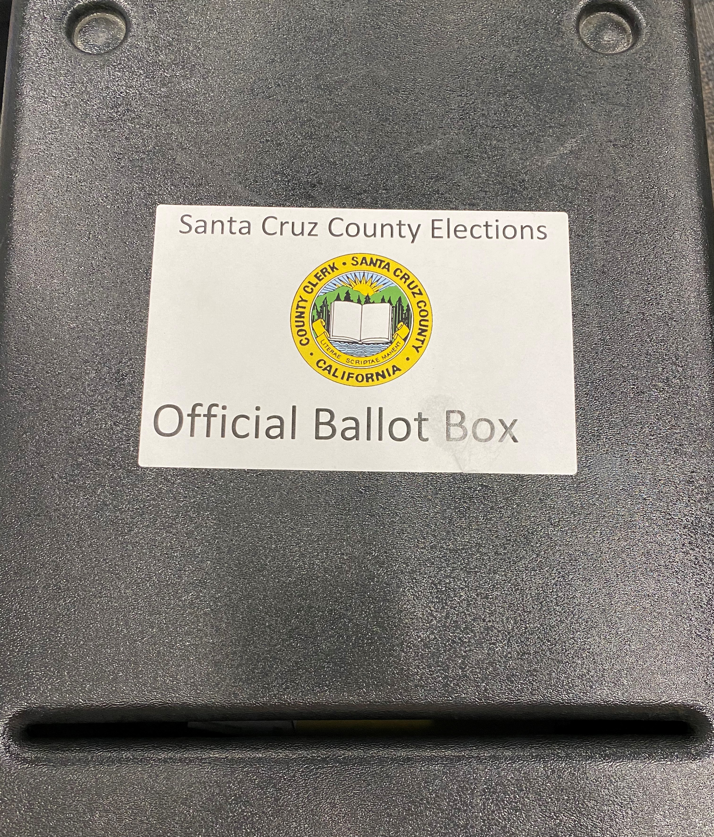
Inside drop boxes are staffed
These boxes are staffed and only available when the office is open to the public. The box is sealed with a cable tie that is broken each time it is emptied. Two-person teams empty the boxes regularly and provide the chain of custody documentation.

Slide 10
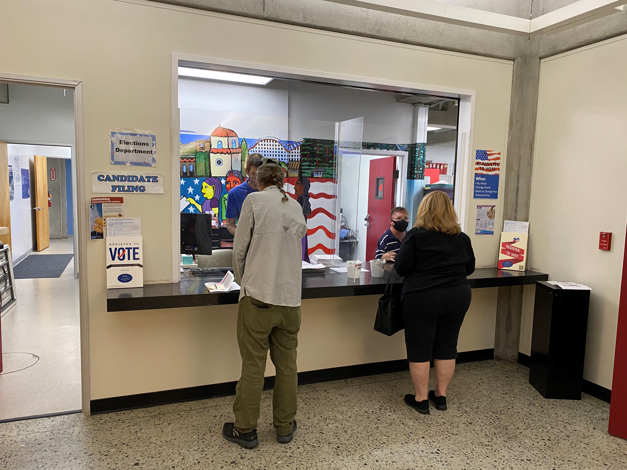
In-Person voting locations open Oct. 31
Our office and Watsonville City Clerk are open now. Monday – Friday, 8am to 5pm.
Aptos - Temple Beth El, 3055 Porter Gulch Rd.
Boulder Creek - Boulder Creek Recreation Hall behind the Fire Station, 13333 Middleton Ave.
Capitola - New Brighton Middle School Multipurpose Room, 250 Washburn Ave.
Felton - San Lorenzo Valley High School Gym, 7105 Highway 9
Santa Cruz - Santa Cruz County Clerk/Elections, 701 Ocean St., Room 310 – Opened Oct. 5 for voting
Santa Cruz - Simpkins Swim Center, 979 17th Ave.
Santa Cruz - Bonny Doon Elementary School Gym, 1492 Pine Flat Rd.
Santa Cruz - Kaiser Permanente Arena, 140 Front St.
Santa Cruz – Masonic Center, 828 N. Branciforte Ave.
Santa Cruz – Gateway (formerly Natural Bridges) School Gym, 255 Swift St.
Scotts Valley - Scott Valley Community Center, 360 Kings Village Rd.
Scotts Valley – Scotts Vally High School Gym, 555 Glenwood Dr.
Soquel - Soquel High School Gym, 401 Soquel-San Jose Rd.
Watsonville - Watsonville City Clerk’s Office, 275 Main St., 4th Floor – Opened Oct. 5 for voting
Watsonville - Pajaro Valley Community Trust, 85 Nielson St.
Watsonville - La Selva Beach Clubhouse, 314 Estrella Ave.
Watsonville - Santa Cruz County Fairgrounds, Harvest Building, 2601 East Lake Ave.
Watsonville - Calabasas Elementary School Multipurpose Room, 202 Calabasas Rd.
Santa Cruz - UCSC, Merrill Cultural Center - open ONLY Monday, Nov. 2, 8am to 5pm and
Tuesday, Nov. 3, 7am to 8pm
16 more will open:
Saturday, October 31, 2020, 9am to 5pm
Sunday, November 1, 2020, 9am to 5pm
Monday, November 2, 2020, 8am to 5pm
Tuesday, November 3, 2020, 7am to 8pm
UCSC will be open Monday & Tuesday ONLY.
Locations are subject to change. Check www.votescount.us for latest information.

Slide 11
Voting location safety checklist
Wear a face covering while at the voting location.
Keep 2 arms’ length distance from other people.
Wash hands before and after entering the voting location.
Use hand sanitizer after touching doors or voting equipment.
Bring your own pen.
We will take your temperature upon entering.
Want more information about how to stay safe while voting?
Review Centers for Disease Control and Prevention guidelines at www.cdc.gov/coronavirus/2019-ncov/community/election-polling-locations.html

Slide 12

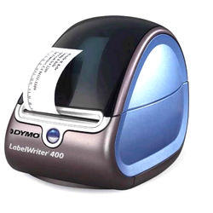

Voting locations will be connected to our voter file
You will give your first and last name to the check in clerk.
If your voter record is found, you will tell them your address where you live and your date of birth.
You can get a ballot to vote there or to go.
When a ballot is issued, the previously issued ballot will be voided.
If you missed the deadline to register to vote, you can register and vote at the voting location.
If your eligibility to vote cannot be confirmed, you will vote provisionally.

Slide 13
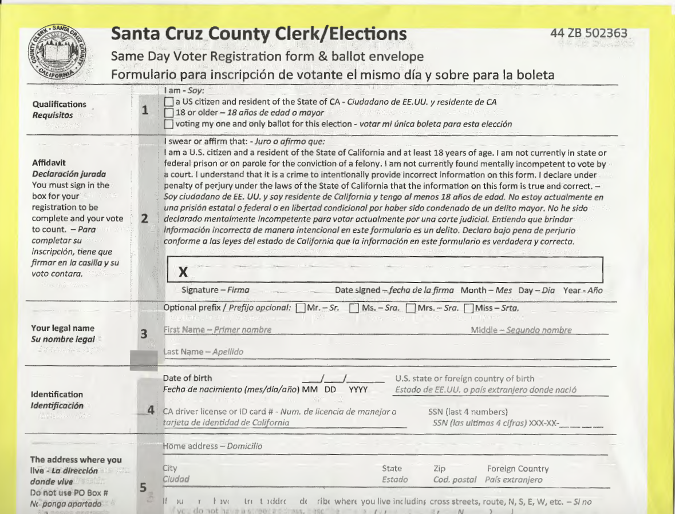
Same Day Voter Registration
If you missed the Oct. 19 deadline to register to vote, you can go to any in-person voting location or the VoteMobile and register and voter.
You cannot take the ballot with you.
You must vote it on site and turn it in.
Ballots will be counted during the canvass after we add you to the voter file, verify your registration, and then we count the ballot.

Slide 14
Provisional Voting – safety net for voters!
We always let the voter vote. If there is question about your eligibility, you will vote provisionally.
Reasons a voter might vote provisionally include:
Voter is a first-time federal voter and unable to show ID
Voter comes in to vote after 8pm on Election Night when the polls have closed
Voter has already voted in the election
Voter is in Santa Cruz County visiting, lives somewhere else, but insists on voting.
What are your options if your provisional ballot is challenged?
You may seek an order from the Santa Cruz County Superior Court to require the elections official to count your ballot at any time prior to completion of the official canvass.
Any judicial action or appeal shall have priority over all other civil matters. A fee shall not be charged to the claimant by the clerk of the court for services rendered in an action under this section.

Slide 15
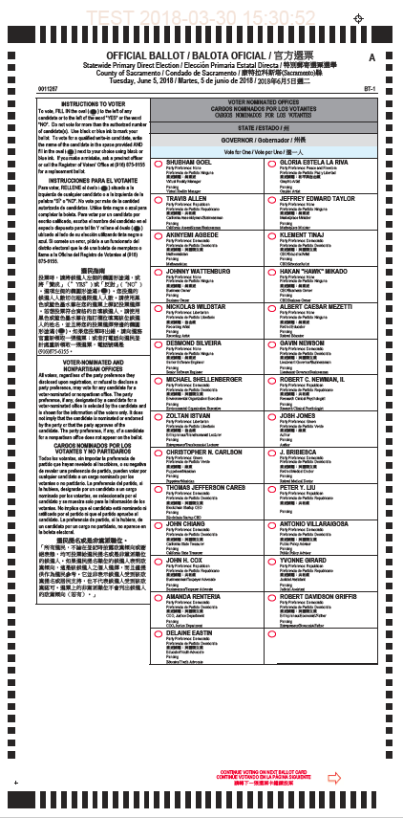
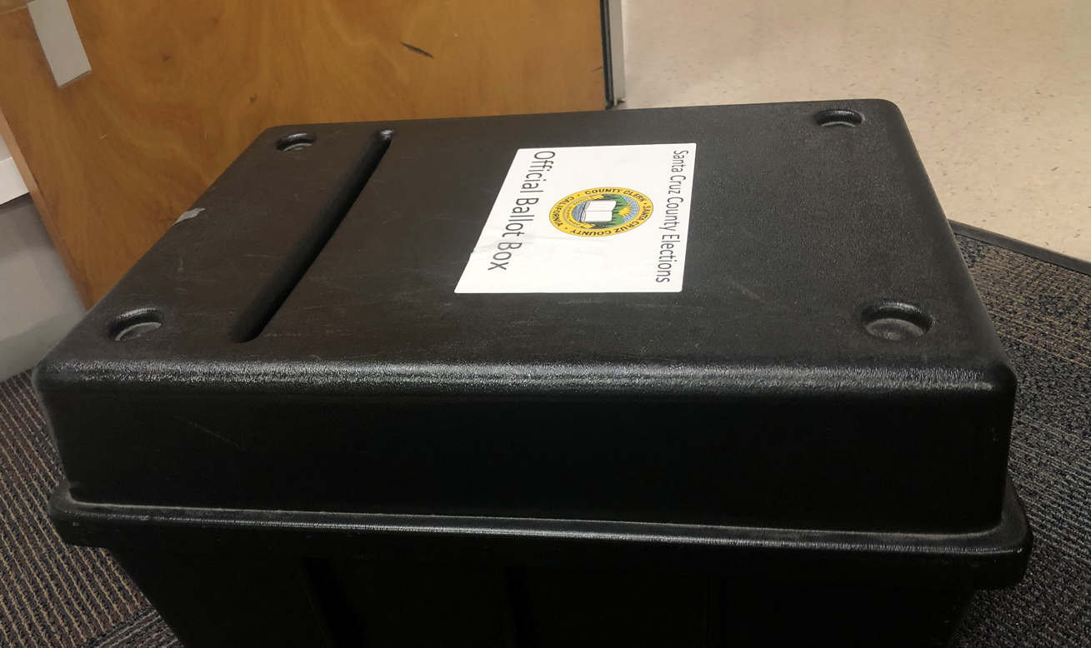
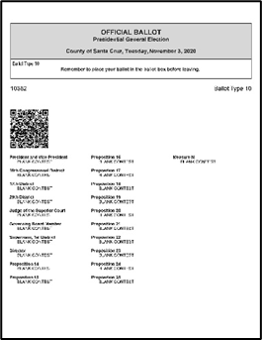
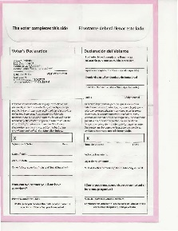
All voters are offered to vote on a
Traditional Paper Ballot or
Use the Tablet to mark a paper ballot
The Tablet has accessibility features that allow a voter with a disability to vote independently and privately. There is also a Spanish ballot on the Tablet.
Curbside voting is also available at all voting locations.

Slide 16
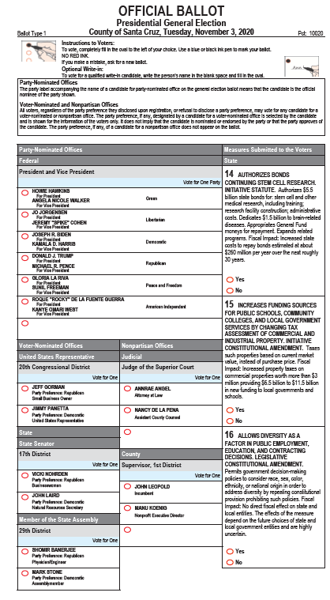
Traditional Paper Ballot
Fill in the oval to the left of your choice.
For most contests, your choice is ONE but for others, like some city council or school and special districts, you may be able to vote for two, three or four candidates.
You may vote for fewer candidates than allowed, but if you vote for more candidates than allowed, your vote(s) in that contest will NOT be counted.

Slide 17
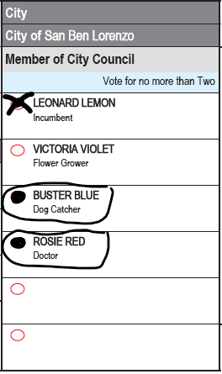
Voting Tips
Voting is NOT a test.
You do not have to vote on every single contest.
If you make a mistake, you can either get a replacement ballot or clearly correct it on the ballot.
To correct your ballot, make a distinct “X” through the mismarked oval, fill in the oval of your preferred choice, and circle your choice. Do not put your initials, name or other identifying marks on the ballot.

Slide 18
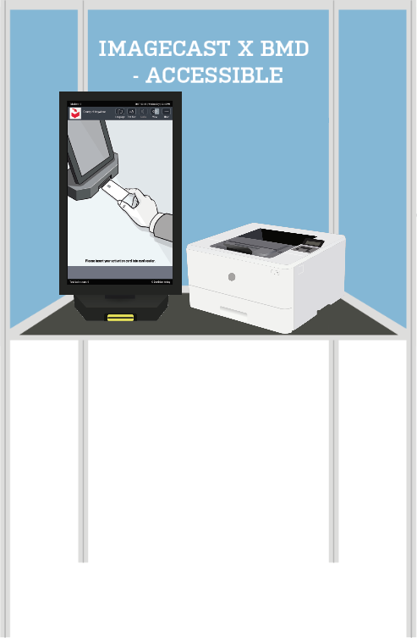
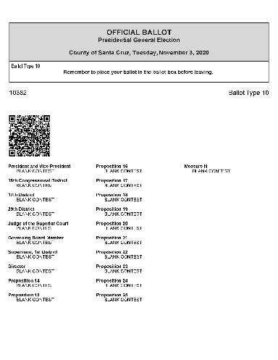
Tablet – Accessible Voting & Spanish Ballot
The tablet does not track nor tally votes, it is NOT connected to the internet, and it is NOT connected to the voter database or any other file.
Ballot activation is done by an elections officer. The precinct code will be on the Tablet Activation Card. If the voter requests an accessible ballot, the elections officer will set that up.
Otherwise the voter takes over at the language selection screen and may select an English or Spanish ballot.

Slide 19
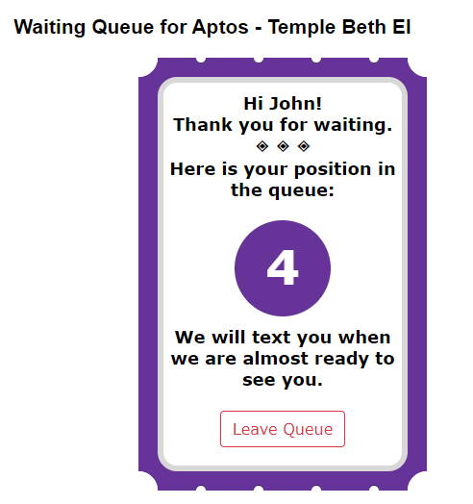
Line Management
Wait Time App
Voters will be let in if there is sufficient space.
If not, you will be put into the queue with your cell phone number, email or you can wait in a designated area.
When it is your turn, you will get an alert to come in and vote.
You can check wait times at the different voting locations online at www.votescount.us or on the My Santa Cruz County App.

Slide 20
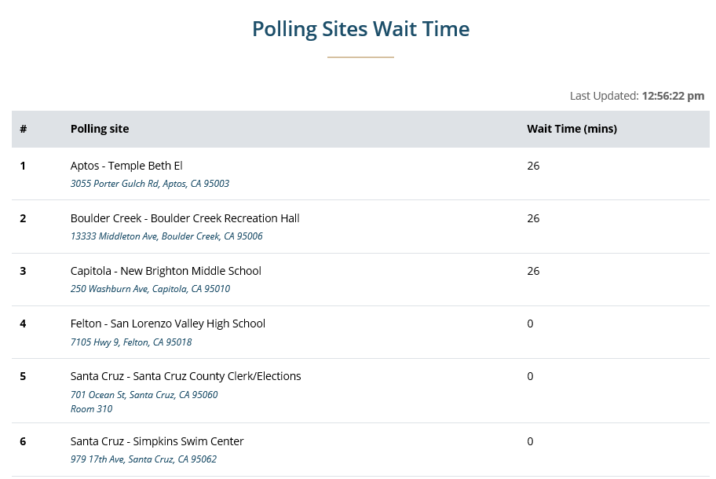

Slide 21
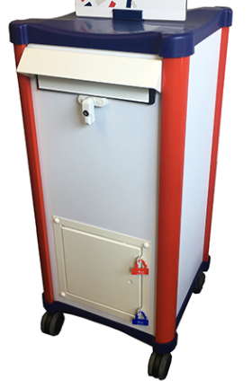
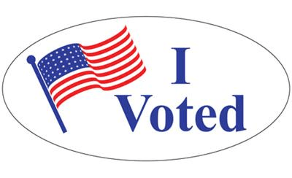
What to expect at in-person voting locations
Dropping off your voted ballot at a voting location
We will have tents outside and a mobile ballot drop box staffed by two people.
You may be able to drive up and drop off your voted ballot, or you may have to park your car and walk up.
The elections clerk will ask you if it is your ballot and if you signed it.
If so, you may deposit it into the box.
If you are not sure if you signed it, the elections clerk will ask you to pull the tab and sign the ballot envelope before you deposit the ballot.
If you are returning the ballot for someone else, the elections clerk will ask you to print your name, sign your name, and write your relationship to the voter in the space provided on the ballot envelope before depositing it into the ballot box.

Slide 22
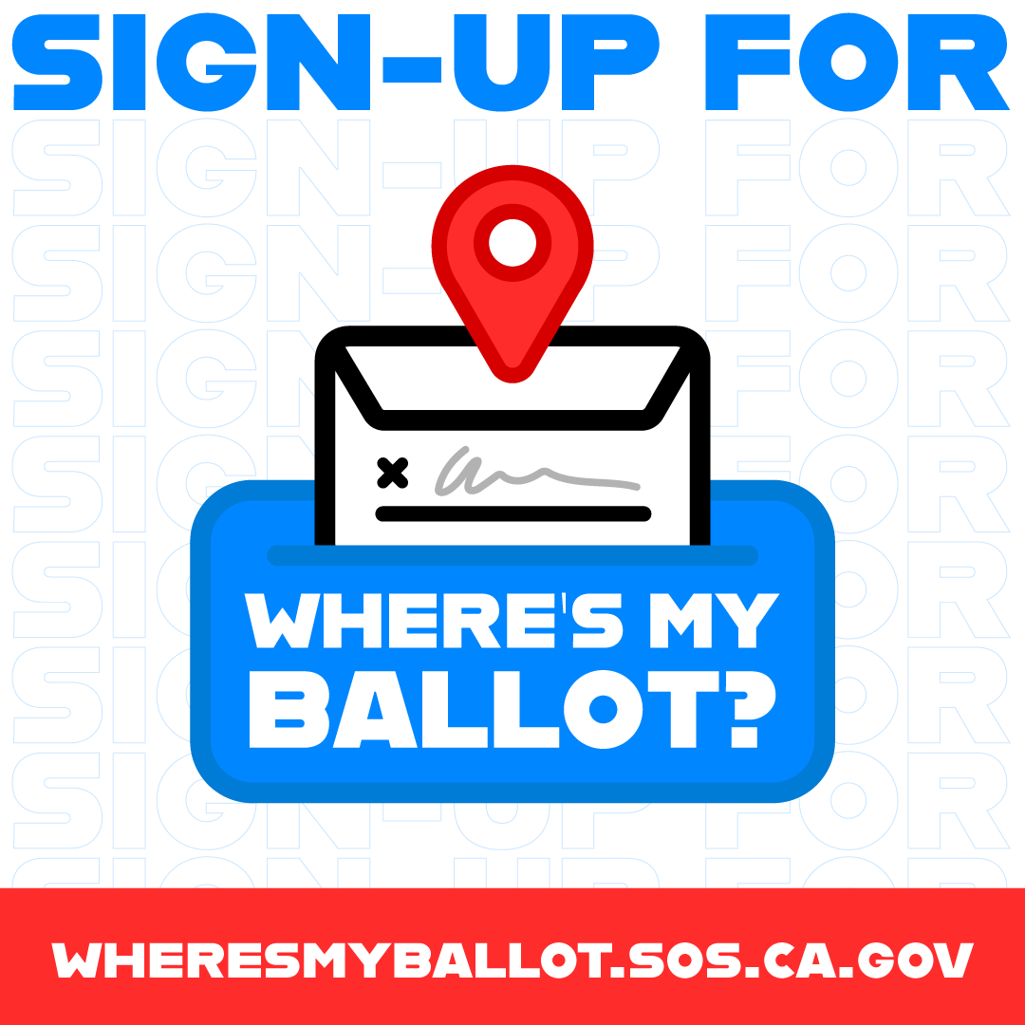
How’s ballot tracking working?
Voters love tracking their ballots.
Alerts are not happening in real time.
It sometimes takes us 48 hours to get your ballot in our office and have your voter record tagged so you get an alert that your ballot was received.
You can still sign up at www.wheresmyballot.sos.ca.gov
Good thing is it will alert voters when we challenge their ballot due to signature not comparing.
Voters want to know that their ballot was counted. Alert says it will be counted. That’s because once the ballot is extracted from the envelope, we can not longer trace it back to an individual voter because it’s a secret ballot.

Slide 23
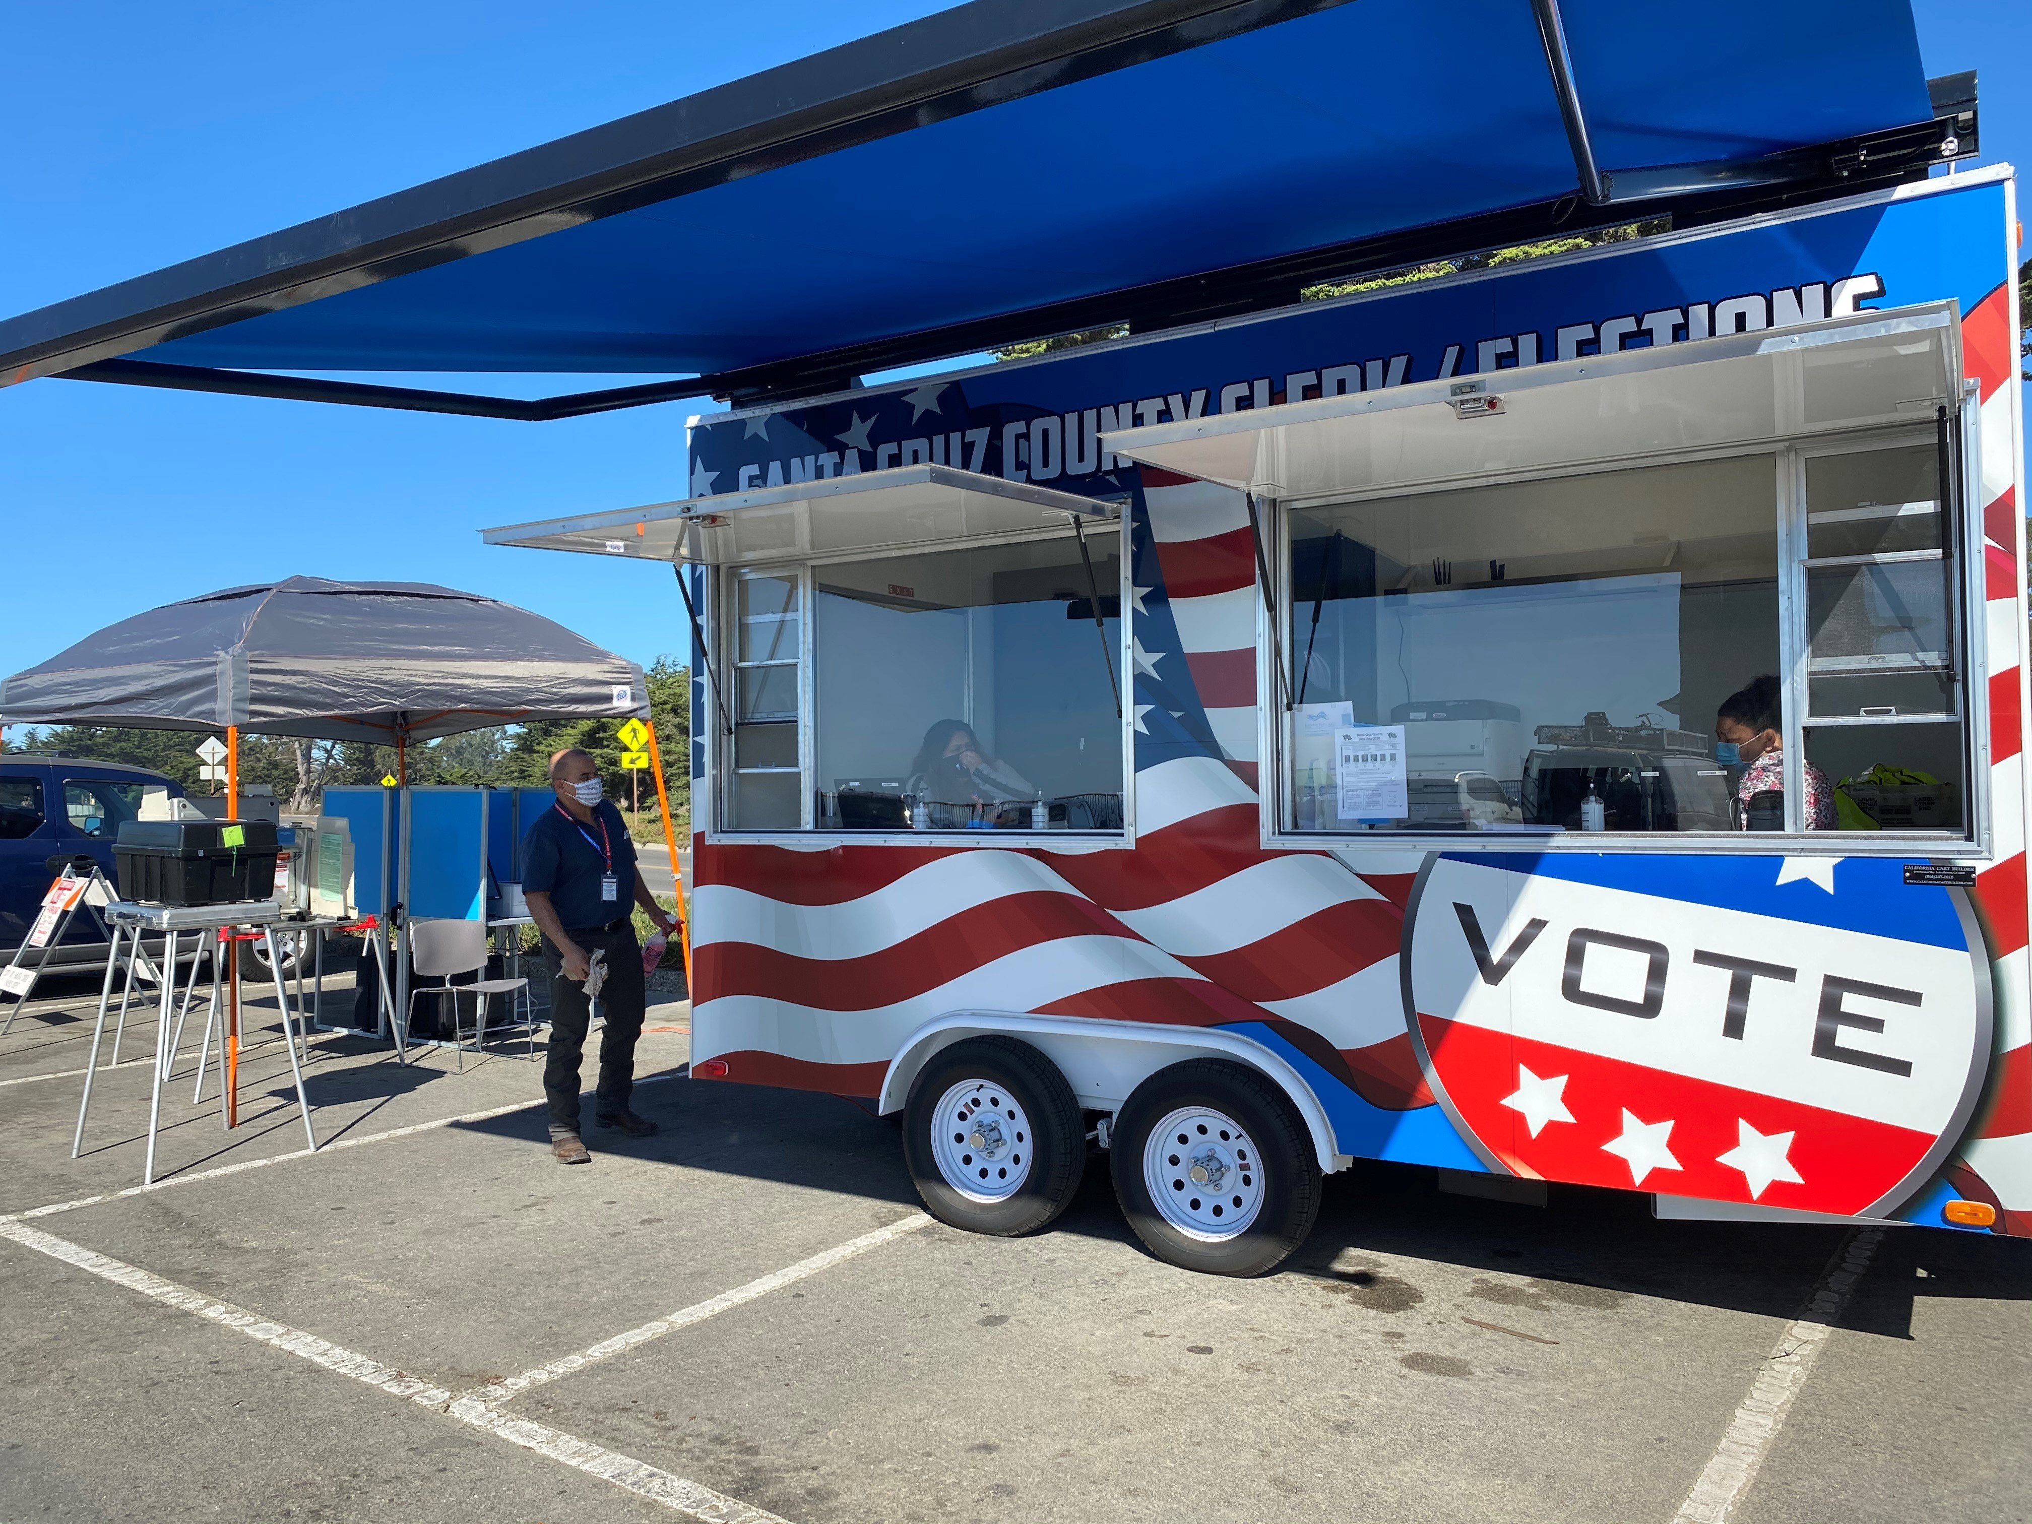
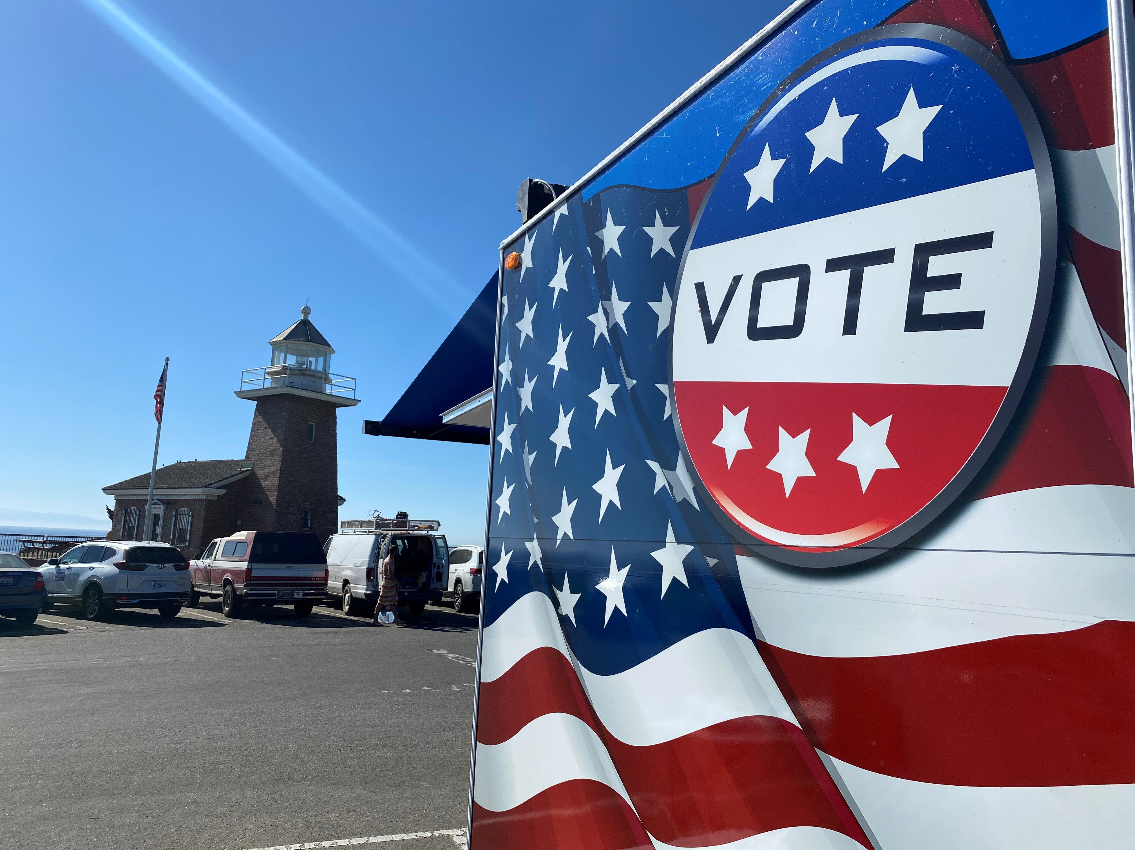
VoteMobile – can go anywhere
Friday. Oct. 30: 3pm to 5pm, Starlight Children's Center, 360 Arthur Rd., Watsonville CA 95076
Saturday, Oct. 31: 9am to 12pm, CT English, 23800 Summit Rd., Los Gatos and we hope to be at Lakeside Elementary from 2 to 5pm.
Sunday, Nov. 1: 9am to 1pm, Davenport
Monday, Nov. 2: Nothing scheduled yet. Tuesday, Nov. 3: Hold for greatest need in the county.

Slide 24
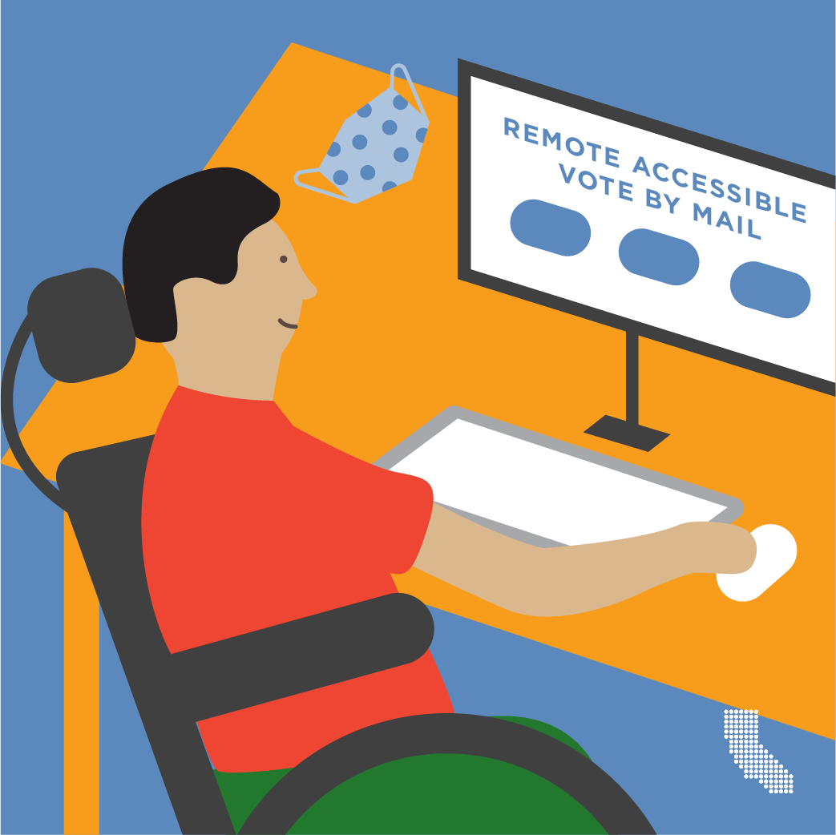
Remote Accessible Vote-by-Mail Ballot - RAVBM
We can email you a ballot if you sign up by October 27: form is online at www.votescount.us or call us at 831-454-2060.
To vote using a RAVBM, you need to have access to a computer, printer and envelopes to return your ballot
We will email you an access code to access your ballot and vote it.
To return your voted ballot, you will need to use your own envelope unless you have the envelope we sent you. If you use your own envelope, you will need to sign it on the outside and print your name, address, and a way to contact you. You may want to put it in a second envelope to protect your information.

Slide 25
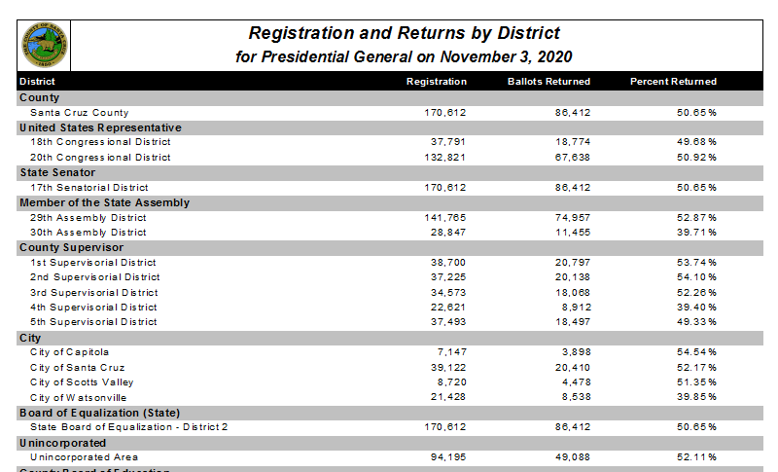
Current numbers. WOW!!

Slide 26
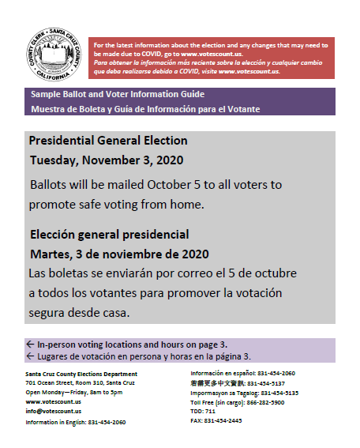
County Voter Information Guide
Guide contains Candidate statements, Local measures, info about voting, drop boxes & voting locations.
We had to make some changes to the printed materials, so check the website at www.votescount.us for the latest information.
Soquel High instead of Soquel Conference Grounds.
Added Gateway School Gym.

Slide 27
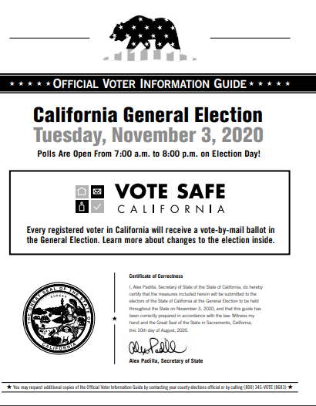
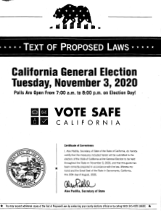
Two State VIGS – only one mailed to voters
This guide contains a summary of the 12 State Props + text of Prop 14.
This guide is not mailed to voters. You have to ask for it. Call 831-454-2060. This guide contains the text of Props 15 – 25.
Both guides are available online at sos.ca.gov

Slide 28
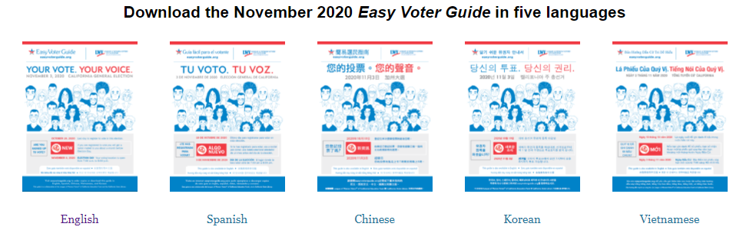
Easy Voter Guide
Produced for statewide elections in California since 1994, the Easy Voter Guide is a collaboration of the League of Women Voters® of California Education Fund and the California State Library. http://www.easyvoterguide.org/

Slide 29

Voter’s Edge
We link to this on our website.
Voter’s Edge California (VEC) is a joint project of MapLight and the League of Women Voters of California Education Fund (LWVCEF).* Voter’s Edge California is a comprehensive, nonpartisan online guide to elections covering federal, state, and local races in the state of California.
https://votersedge.org/ca

Slide 30

If your signature is challenged
If your signature is missing from your ballot envelope or challenged because it does not compare, we will contact you.
If you sign up for WheresMyBallot.sos.ca.gov you will get an alert.
You have until Nov. 29 to cure your signature by completing a form we will mail to you. The form is also posted on our website.

Slide 31

No electioneering
No one can solicit the vote of a vote-by-mail voter, or do any electioneering, while in the residence or in the immediate presence of the voter, and during the time he or she knows the vote-by-mail voter is voting.
Electioneering is also prohibited within 100 feet of a voting location and a drop box.
Any person who knowingly violates this section is guilty of a misdemeanor.

Slide 32

Observers at the Polls
We have always had observers at the polls.
Observers may not challenge a voter. Nor can they disrupt the voting process.
Observers must be neutral in their appearance and must wear a mask at all times.
Observers will be asked to sign in and out of the voting location.
Any questions about procedures must be directed to Gail or Tricia.
If someone gets out of hand, the election workers have been told to call their Rovers, the hotline or law enforcement.

Slide 33
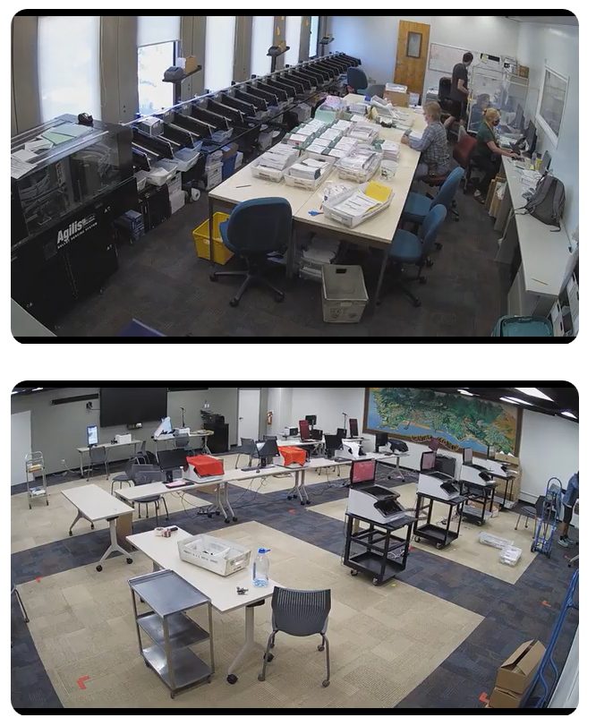
Observers are always welcome
Cameras are installed so you can watch our ballot processing and counting from the safety and comfort of your own home.
Ballot counting has been moved to the Community Room in the basement at 701 Ocean St.
Information about observing our processes is posted online at www.votescount.us
If you would like to be an election observer, please notify:
  Gail Pellerin at gail.pellerin@santacruzcounty.us, 831-454-2419, or
  Tricia Webber at tricia.webber@santacruzcounty.us, 831-454-2409

Slide 34
If you see something, SAY SOMETHING!
If you suspect voter fraud, please contact the Secretary of State. They have a complaint form posted online at https://www.sos.ca.gov/elections/publications-and-resources/voter-complaint/
You may also call the Secretary of State at:
English: (916) 657-2166 or (800) 345-VOTE (8683).
Spanish: (800) 232-VOTA (8682)
You may also contact the Santa Cruz County Clerk at 831-454-2060 or info@votescount.us. The County Clerk is not authorized to do investigations, so the office will refer the case to the appropriate local agency.

Slide 35
Help us spread the word!
Be a trusted messenger!
If voters have not received a ballot yet, it’s too late to mail them a replacement ballot. They need to vote in person.
If the voter is not in Santa Cruz County, we can still assist them with voting. They need to call our office at 831-454-2060 and we can do a voter assist.
Voting is available Friday – Tuesday. Vote early to avoid the lines.
If you do show up to vote and there is a line, we can text you when it is your turn to vote.
Ballots can still be mailed in CA. Ballots must be postmarked by Nov. 3. At this point, walk it in to the Post Office and get the envelope postmarked.

Slide 36
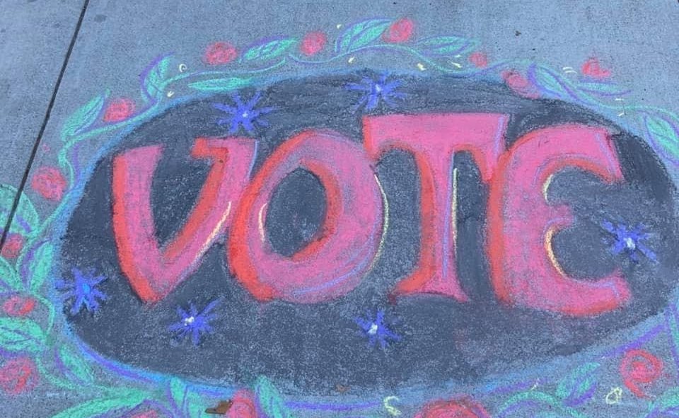
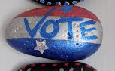
How you can spread promote the vote!
Talk to your family, friends, neighbors
Chalk art
Rock art
Car art
Social media
Email
Yard signs to promote voting!

Slide 37

Delivering democracy takes many people
Voting locations – 17 or more clerks will be at each voting location.
A team has been assigned to manage the VoteMobile.
Two-person teams have been assigned to manage the ballot drop boxes.
Election Worker hotline – staffed by county employees and some volunteers.
Voter Hotline – staffed by county employees.
A huge THANK YOU to all our staff, extra help, county workers and volunteers!

Slide 38

Key dates and milestones
Oct. 29, 2020 – 5 more days of voting!
Oct. 31, 2020 – Happy Halloween – 16 additional in-person voting locations open.
Nov. 2, 2020 – UCSC voting location opens.
Nov. 3, 2020 - Election Day - the last day to vote!
Nov. 29, 2020 – Last day to cure a signature.
Dec. 1, 2020 – Deadline to certify the election.

Slide 39
Assuming Office Dates
December 4 – Special Districts: Candidates declared elected or appointed take office this date at noon after having taken the oath or posted any bond required by the principal act. §10554
December 4 – School and Community College Districts: Candidates elected to school board take office, though no reference is made to “noon.”
December 7 – State Senate and State Assembly Members take office.
December 8 – Santa Cruz & Watsonville City council members take office.
December 10 – Capitola City council members take office.
December 16 – Scotts Valley City council members take office.
January 3 – Congressional members take office.
January 4 – County Supervisors and Superior Court Judges take office.
January 20 – Inauguration Day. President takes office at noon.

Slide 40
What to expect Election Night
8:15pm - First returns released will be the mailed ballots returned and processed, plus any in-person ballots voted prior to Nov. 3.
9pm – As ballots come in from the voting locations, they will be scanned. On Election Night, will not be able to count the mailed ballots, same day voter registration or provisional ballots cast at the voting locations on Nov. 3. Those ballots will be counted during the canvass.
10:30pm – Update of Vote Count totals
After midnight – We will post Semi-Official Election Night results. These will NOT be final results.

Slide 41
The Canvass
Outstanding ballots - There will be thousands of outstanding ballots to be counted during the canvass: remaining mailed ballots returned by voters, same day voter registration ballots, provisional ballots, damaged ballots, ballots that need to be duplicated, etc. The semi-official results will be available in hardcopy at the office and online at www.votescount.us.
What’s the Canvass all about? - The Official Canvass will begin Wednesday, November 4. The canvass includes processing all remaining ballots, adding same day voter registrations and processing their ballots, researching any provisional ballots, auditing the polls, and conducting a hand count of every contest at least once. For close contests, the hand count will be escalated.
A random drawing of the precincts subject to the 1% manual tally will take place at 10am, Thursday, November 5. Ballots will be coming in from the mail since the law has changed to allow ballots postmarked on or before Nov. 3 to be considered received on time if we get them by Nov. 20. Also, any voter in the State of California can return their ballot to any drop box or voting location in the State of California, so those ballots will come in from other counties after Election Day.
We will do an update to the vote count each day and release the updated results around 4pm each day. We will also estimate each day how many ballots remain outstanding. We will not be able to tell you how many ballots are left to be counted in any particular jurisdiction.

Slide 42

When will we be done?
We hope to have most of the ballots in and counted before the Thanksgiving holiday. Pursuant to Elections Code §15375, the elections official shall prepare a certified statement of the results for the presidential election within 28 days of the election which is Tuesday, December 1. We plan to certify all results for all contests by that date.

Slide 43
When will other States be done?
Each state has a different timetable for the canvassing a general election, which involves compiling returns, making sure every ballot is accounted for and certifying the results. The process usually takes place later in November and sometimes extends into December.
This year, close margins will increase the likelihood of legal fights over which ballots should count. But a handful of deadlines will also place pressure on courts to resolve disputes quickly.
States are supposed to appoint presidential electors by Dec. 8 — or at the latest, Dec. 14, when the electors meet in state capitals to cast their votes. Certificates of election from the states are counted by members of Congress on Jan. 6.

Slide 44
The Electoral College
On November 3, 2020, registered voters in each state cast their ballots for the Office of President and Vice President.
Each state is allocated a number of Electors equal to the number of its U.S. Representatives plus its two senators. In CA the total electoral votes is 55 – 2 Senators and 53 members of the House of Representatives.
The candidate with the most electoral votes – 270 or more – (over one half of the total vote of 538) is declared President.
Whichever presidential candidate gets the most popular votes in a State wins all the Electors for that state except for the states of Maine and Nebraska which award electoral votes proportionately.
The Candidate With the Most Votes Does Not Always Win: In the past 125 years, there have been four occasions when a presidential candidate won the popular vote, but lost the election: in 1876, Samuel J. Tilden won the popular vote, but Rutherford B. Hayes won the electoral vote, and, therefore, the election; and in 1888, Grover Cleveland won the popular vote, but Benjamin Harrison won the election. In 2000, Al Gore won the popular vote, but George Bush was elected President. In 2016, Hilary Clinton won the popular vote, but Donald Trump was elected President.

Slide 45
National Popular Vote
The National Popular Vote bill will take effect when enacted into law by states possessing 270 electoral votes (a majority of the 538 electoral votes). As of July 2020, it has been enacted into law in 16 jurisdictions possessing 196 electoral votes, including 4 small states (DE, HI, RI, VT), 8 medium-sized states (CO, CT, MD, MA, NJ, NM, OR, WA), 3 big states (CA, IL, NY), and the District of Columbia.
The bill will take effect when enacted by states possessing an additional 74 electoral votes.
The National Popular Vote bill has now passed a total of 41 state legislative chambers in 24 states. It has also passed at least one legislative chamber in 9 states possessing 88 electoral votes (AR, AZ, ME, MI, MN, NC, NV, OK, VA). It has been unanimously approved at the committee level in 2 states possessing 27 more electoral votes (GA, MO). The National Popular Vote bill has been introduced in various years in all 50 states.

Slide 46
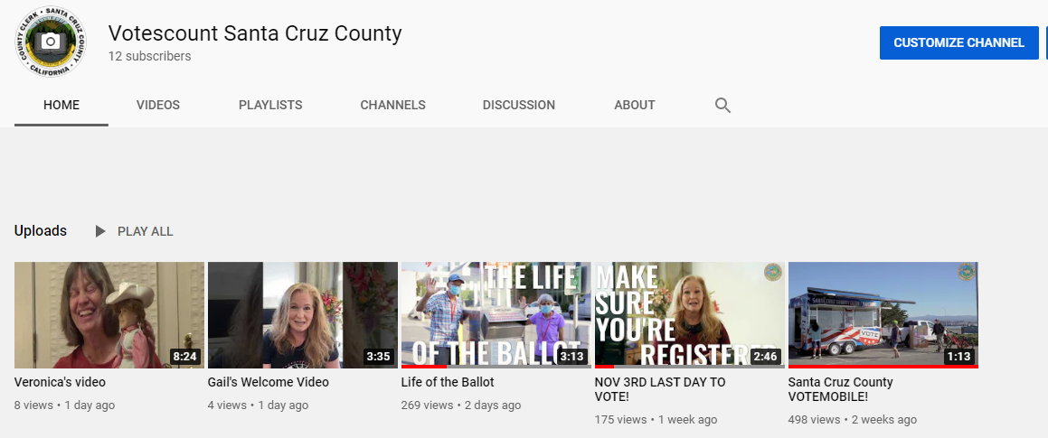



Thank you for participating and Thank you for voting!
Check out our Videos!!
Votemobile = https://www.youtube.com/watch?v=b0yCn9ykwb4
Nov. 3 – The last day to vote = https://www.youtube.com/watch?v=BPmCrZW6tL0
Life of the Ballot = https://www.youtube.com/watch?v=3_DzkC39CvA
Gail L. Pellerin
County Clerk
831-454-2060 (main)
831-454-2419 (direct)
info@votescount.us
www.votescount.us

